Slide 1


Slide 2
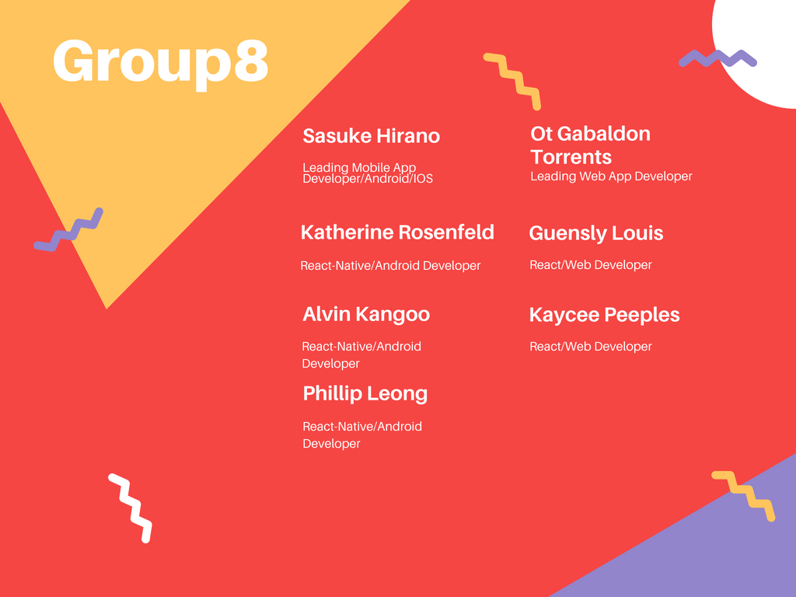

Slide 3
Introduction and Synopsis
Open-environment for studying
No confinement by the restraints of Facebook or GroupMe for a single course, you are now open to an entire community of people for an unlimited amount of courses and topics.
Develop communities for similar interest of studies
Coordinate face-face meetup in local area

Slide 4
What is the project?
The project is a meet up app, named Studbud.
Social Networking app, with authentication, profiles, dashboard, posts, groups, etc.
Give users the ability to search for study groups using keywords as well as hash tags.
Can use geolocation or zip code to find study groups locally.
Moderator privileges within study groups.
In-app user communication, ability to notify all users of a specific group by push, email, or SMS.
Using MongoDB, Express, Redux, and Node.js (MERN) stack development.

Slide 5
Features
Privacy and Security
Notifications of user activity within joined groups
Customizable individual profiles
Ability to create public and private groups
Add relevant hash tags to groups
Voice and Audio chat with group members
Users can communicate privately with one another within the app

Slide 6
Frameworks and Software
Web application and Mobile application will be implemented with MERN(MongoDB Express Redux Node.js) stack development
Front-end development will be done with react(Web) and react-native(mobile app)
Database for both react and react- native will be situated and maintained through MongoDB which stores data as JSON folders.
Redux is a JavaScript library which will be utilized for state management.
Node.js will support routing of requests and access to the backend API.

Slide 7
// Improvements needed
Constantly needing to improve the end product for quality assurance.
Whether it is a UI or UX component, many tweaks have to be made for the app to be fully functional and complete.
Debugging and testing numerous times to routinely remove bugs, errors, or abnormalities.
Support page for users to give us their input to improve the app.

Slide 8
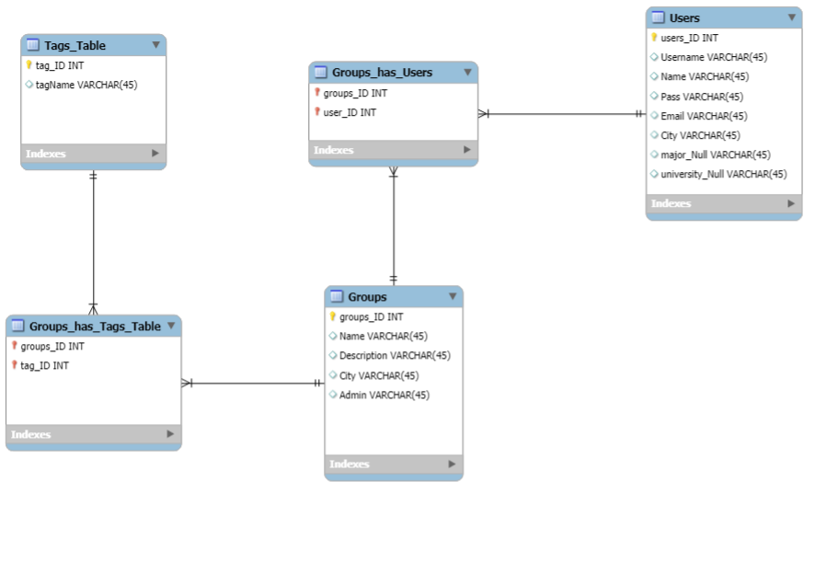
Entity Relationship Diagram(ERD)

Slide 9
Expected challenges/delays
Lack of communication due to poor use of slack. Only a few members were initially using the software which made it difficult to pass on important announcements and information to the entire group.
Ineffectively distributed tasks without fully knowing or understanding the specifications of the project
The aforementioned led to loss of time and slowed down the development process.
Several group members were working on all parts of project in order to achieve a better understanding and provide functional, working prototypes.

Slide 10
Summary

Slide 11


